Slide 1
Inverse Optimization and Applications in Fairness
Research Talk
Ari Smith

Slide 2
Overview
Context of Fairness in Data Science
Inverse Optimization as an Analytical Tool
Application 1: Assessing Congressional Gerrymandering
Application 2: Detecting Biased Training Sets in Machine Learning
Ari Smith: Inverse Optimization and Fairness

Slide 3
Fairness

Slide 4
Quantifying Fairness
Fairness in sociotechnical systems can have a variety of meanings across different contexts
Many systems still operate on “know it when you see it” definitions of fairness
Improving fairness in systems can be challenging without a quantitative way to assess it
Fairness, Accountability, and Transparency is a rapidly growing interdisciplinary field in computer science/data science research
Ari Smith: Inverse Optimization and Fairness

Slide 5
Quantifying Fairness
Many quantitative methods in fairness involve producing new metrics that correspond to some set of values about fairness, and working towards optimizing metrics or meeting cutoffs
When stakeholders hold differing conceptions/values about fairness, applying these methods can lead to difficulties, and sometimes satisfying multiple definitions of fair is not possible
We introduce a methodology to reveal how certain metrics/values are prioritized over each other in design decisions, to bring more nuance into investigation of what constitutes fairness in systems
Ari Smith: Inverse Optimization and Fairness

Slide 6
Inverse Optimization

Slide 7
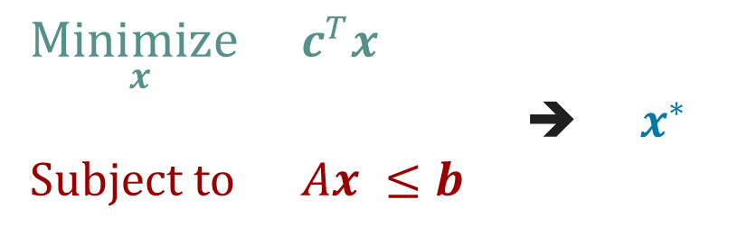
Structure of Optimization Problems
Optimization problems can be thought of as having three components:
Decision Space
Objective Function
Optimal Solution
Find optimal solution given decision space and objective function
Refer to this as the Forward Problem (FP)
$\underset{x }{Minimize}$ $c^{T}x$
➔ $x^{∗}$
Subject to $Ax ≤b$
Ari Smith: Inverse Optimization and Fairness

Slide 8
Structure of Inverse Optimization Problems
In Inverse Optimization, the set of known and unknown components is different
Decision Space
Objective Function
Optimal Solution
The optimal solution is known, and we seek model parameters of FP for which it is optimal (most often, find the objective function)
Often applied in decision analysis/calibration contexts
$\underset{x }{Minimize}$ $c^{T}x$
➔ $x^{∗}$
Subject to $Ax ≤b$
Ari Smith: Inverse Optimization and Fairness

Slide 9
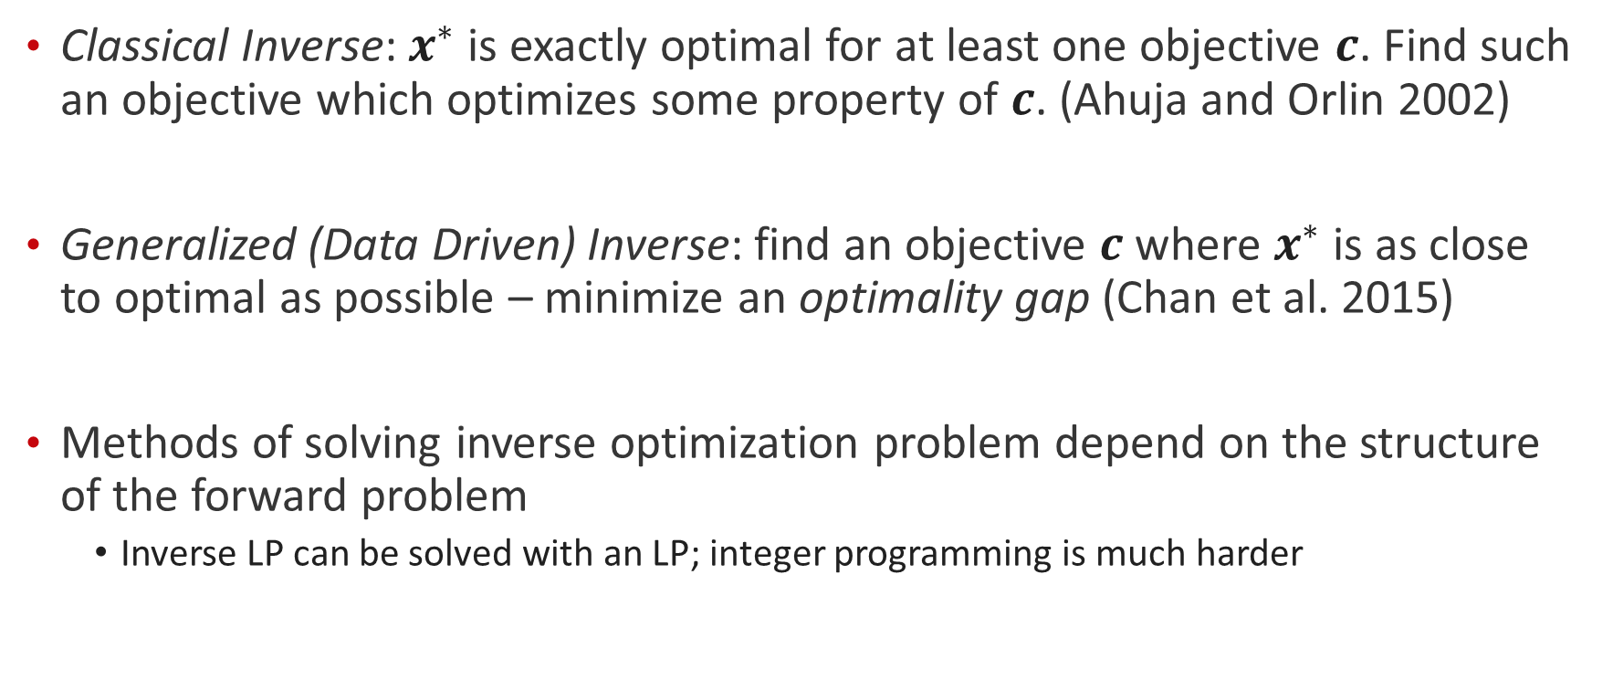
Types of Inverse Optimization Problems
Classical Inverse: $x^{∗}$ is exactly optimal for at least one objective $c$. Find such an objective which optimizes some property of $c$. (Ahuja and Orlin 2002)
Generalized (Data Driven) Inverse: find an objective $c$ where $x^{∗}$ is as close to optimal as possible – minimize an optimality gap (Chan et al. 2015)
Methods of solving inverse optimization problem depend on the structure of the forward problem
Inverse LP can be solved with an LP; integer programming is much harder
Ari Smith: Inverse Optimization and Fairness

Slide 10
Application 1: Congressional Gerrymandering

Slide 11
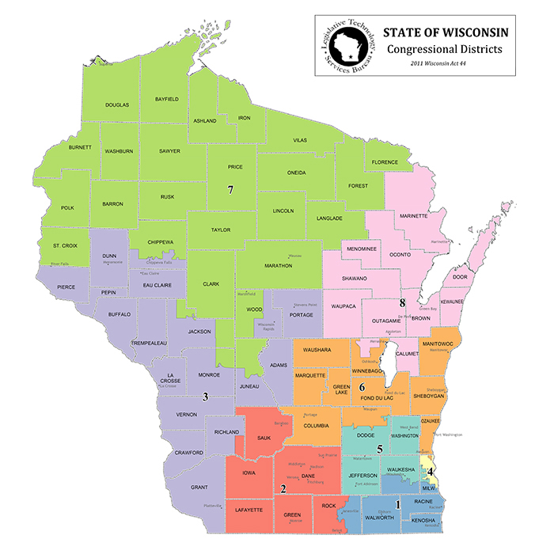
Congressional Redistricting
In the U.S. government, states are spatially partitioned into districts; each elects one legislative seat
Constitution requires that districts be of equal population, contiguous, and compact
Every 10 years, districts are redrawn after the U.S. Census to ensure that shifting populations do not imbalance citizens’ voting power
Ari Smith: Inverse Optimization and Fairness

Slide 12
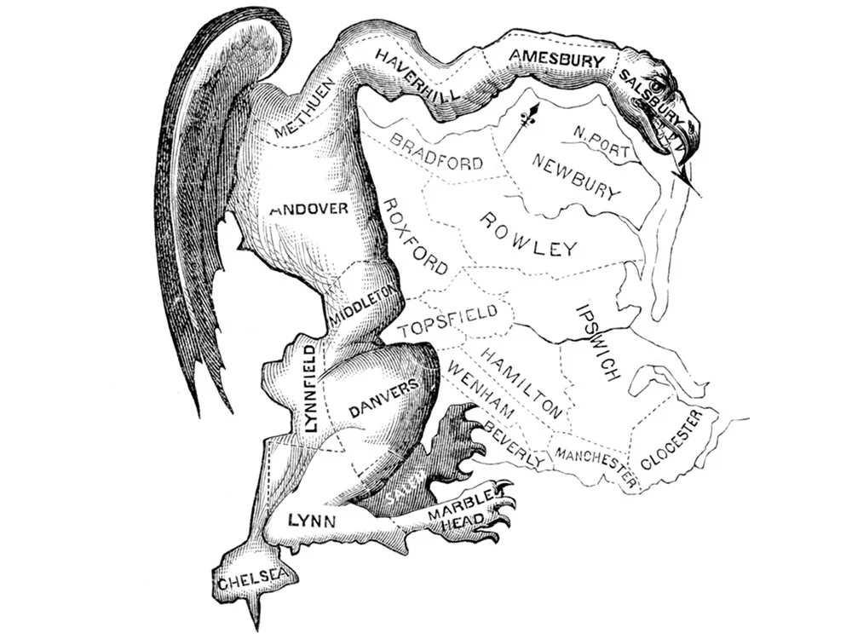
Issue of Gerrymandering
Redistricting is intended to rebalance voting power equitably, but districts are often alleged of the opposite; they empower one group over others
This is referred to as Gerrymandering
Partisan Gerrymandering is when the imbalance is across political parties
Subject of court disputes, has been hard to prevent due to lack of quantitative criteria for defining it
Ari Smith: Inverse Optimization and Fairness

Slide 13
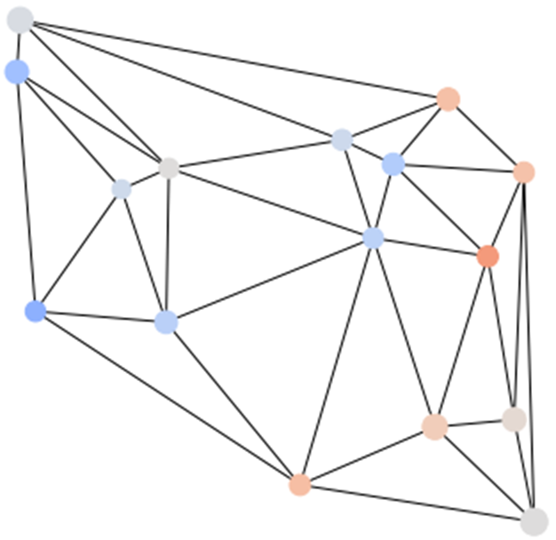
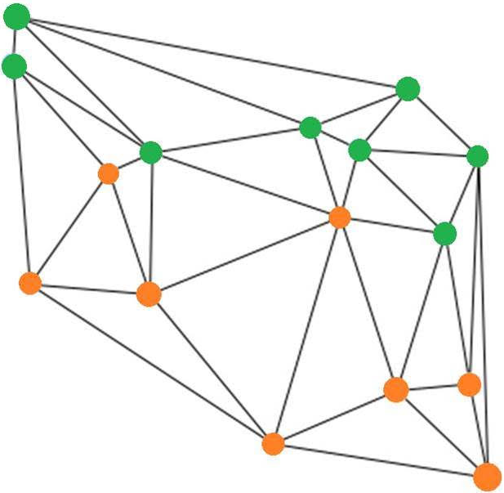
Modeling District Design with Optimization
Swamy et al. (2022) provide an FP formulation that finds districtings which optimize a weighted combination of different desired properties
Based on forming districts by grouping together census blocks – graph partitioning problem
Formulation is a Mixed Integer Linear Program (MILP) which is NP-Hard
Ari Smith: Inverse Optimization and Fairness

Slide 14
Applying Inverse Optimization to Redistricting
Using existing districts as observed solution, discover what weighted combination of metrics the districting is closest to optimizing
Examined metrics:
Population Imbalance: maximum deviation from mean population
District Compactness: quantified with p-median compactness
Efficiency Gap: popular metric of partisan fairness, measures “wasted votes”
If the found objective shows an undemocratic value (maximizing efficiency gap) is prioritized over a required objective (compact districts), then the districts are gerrymandered and should be redrawn
Ari Smith: Inverse Optimization and Fairness

Slide 15
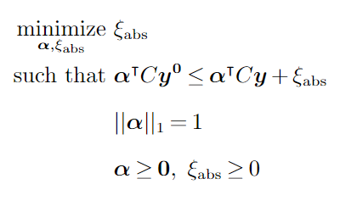

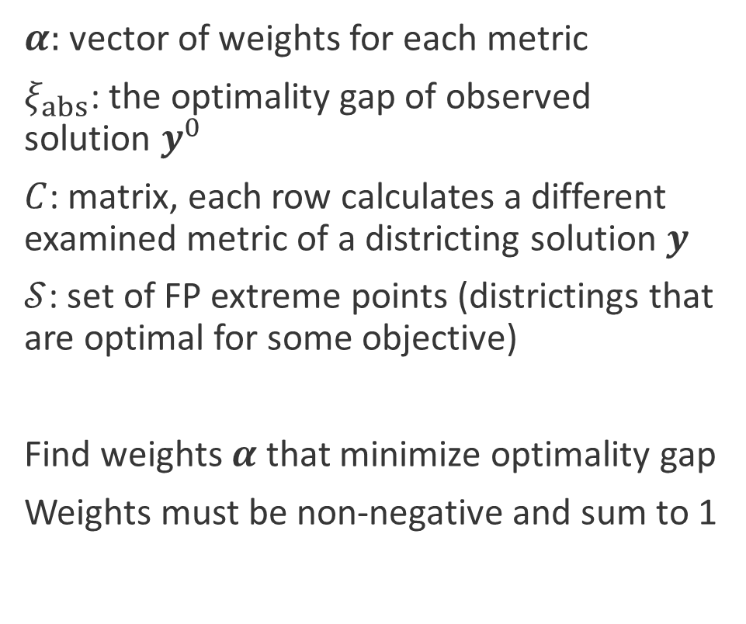
Inverse Optimization Problem Setup
$α$: vector of weights for each metric
$ξ_{abs}$: the optimality gap of observed solution $y^{0}$
$C$: matrix, each row calculates a different examined metric of a districting solution $y$
$𝒮$: set of FP extreme points (districtings that are optimal for some objective)
Find weights $α$ that minimize optimality gap
Weights must be non-negative and sum to 1
Ari Smith: Inverse Optimization and Fairness

Slide 16
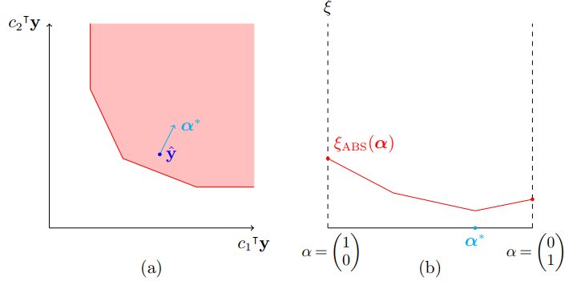
Solution Approaches for Inverse Problem
Existing methods for solving inverse optimization for MILPs utilize cutting plane methods (Wang 2009, Moghaddass and Terekhov 2020)
We show how to calculate the subgradient of the optimality gap, and apply descent-based methods
Projected Gradient Descent,
Polyak Acceleration, Frank-Wolfe
Ari Smith: Inverse Optimization and Fairness

Slide 17
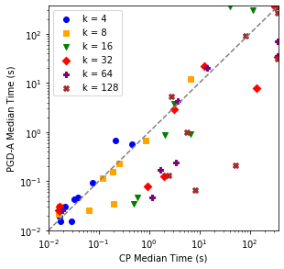
Solution Approaches for Inverse Problem
Existing methods for solving inverse optimization for MILPs utilize cutting plane methods (Wang 2009, Moghaddass and Terekhov 2020)
We show how to calculate the subgradient of the optimality gap, and apply descent-based methods
Projected Gradient Descent,
Polyak Acceleration, Frank-Wolfe
Compare methods on bank of MILP problems
Projected gradient descent with acceleration
outperforms cutting planes in most test cases
(90% time reduction for instances with 128 variables)
Ari Smith: Inverse Optimization and Fairness

Slide 18
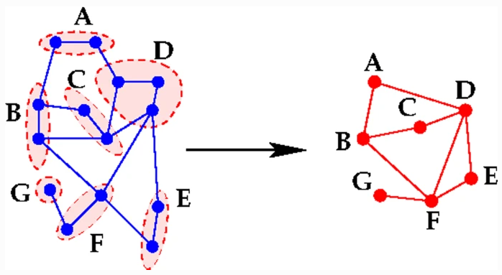
Heuristic Approaches for Districting Application
Methods still involve solving FP multiple times, which is costly
Coarsening the underlying graph of the state allows for quick approximations of FP solution by shrinking set of possible districtings
Creating ensembles of different random coarsenings of the same graph allows us to recover more possible districtings, for closer approximations, while still reducing computation time
Ari Smith: Inverse Optimization and Fairness

Slide 19
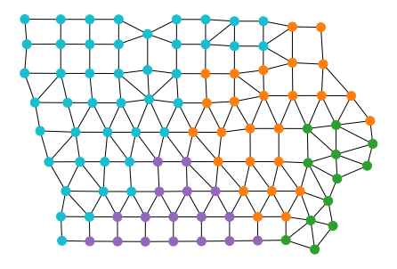
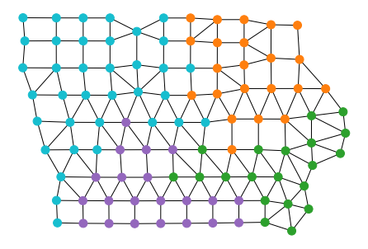
Case Study: 2021 Iowa Districts
Iowa districts drawn by independent commission
In 2021, legislature rejected one district plan, then accepted another
Rejection claimed a need to prioritize population balance more
Accepted districts also gave one more Republican seat than rejected
Claim backed up by inverse analysis
Metric | Rejected District Weights | Accepted District Weights
Population Imbalance | 0.933 | 1
Compactness | 0.055 | 0
Efficiency Gap (minimize) | 0.011 | 0
Ari Smith: Inverse Optimization and Fairness

Slide 20
Future Work Opportunities
Utilize partial linear relaxations of FP to get lower approximation of optimality gap
Apply ensembles of different relaxations similar to coarsening approach
Combine upper bounds with lower bounds from coarsening to get firm bounds on inverse-optimal solution
Using Frank-Wolfe algorithm allows possible ways of solving IO with subgradient method without having to fully solve FP at every step
Could potentially cut down solution time significantly
Ari Smith: Inverse Optimization and Fairness

Slide 21
Application 2: Biased Training Sets in Machine Learning

Slide 22
Issues with Training Data in Machine Learning (ML)
Imbalances in representation of certain groups in datasets that train machine learning models can lead to inequitable performance of models across groups
Ex: racial bias issues in facial recognition models
One difficulty in addressing this is that many proprietary ML models in use keep their datasets private
Ari Smith: Inverse Optimization and Fairness

Slide 23
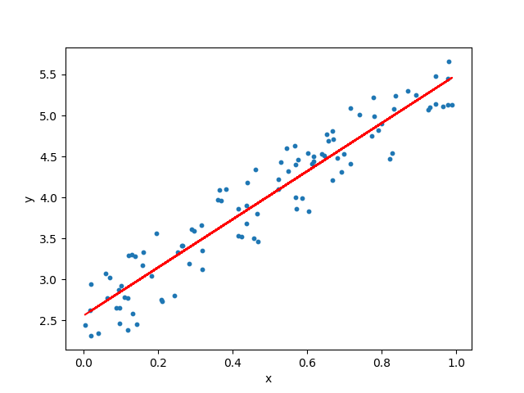
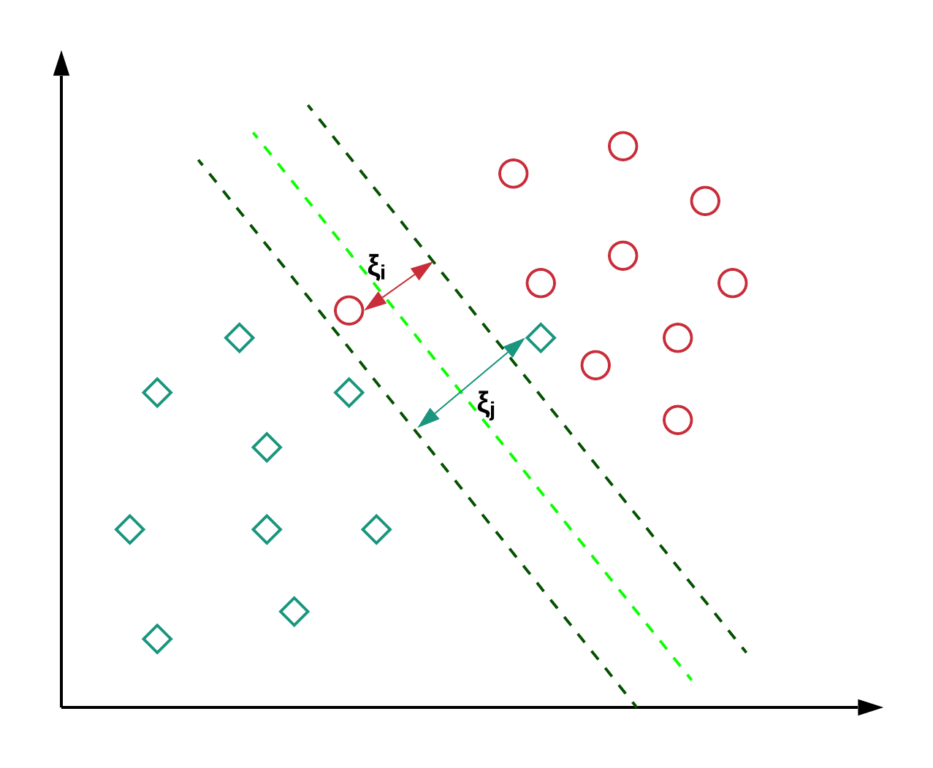
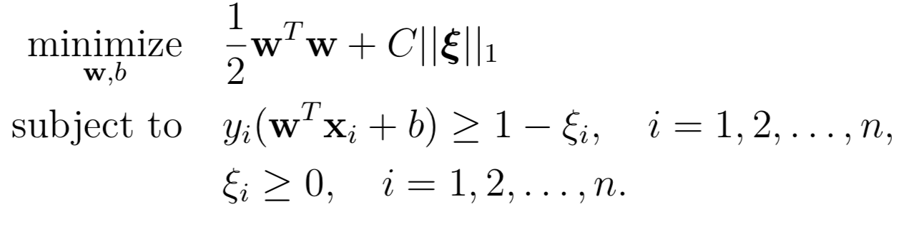

ML Models as Optimization
$$\underset{β }{minimize}{\frac{1}{n}\sum_{i=1}^{n}{{(β^{T}x_{i}−y_{i})}^{2}}}$$
Ari Smith: Inverse Optimization and Fairness

Slide 24
ML Models as Optimization
Many ML models that are trained with optimization are fit to minimize some function of prediction error over their training data
Ridge Regression (Hoerl and Kennard 1970), Soft Margin SVM (Cortes and Vapnik 1995), Optimal Decision Trees (Bertsimas and Dunn 2017)
Error function is often summed uniformly across training observations, but it is also common to put different amount of weight on different observations
Often reweighted when a certain group is vastly underrepresented to fix inequity
Observation weights are adjustable parameters of objective function
Ari Smith: Inverse Optimization and Fairness

Slide 25
Application of Inverse Optimization
Suppose we have an ML model with a secret training dataset, that we can use for prediction as a black box
Make predictions on a known dataset, then utilize inverse optimization to infer what distribution of observation weights on known dataset would result in the predictions made by model
Finding low weights across a class of observations could indicate they are underrepresented in the secret training set compared to known dataset
Not only indicates evidence of bias in model, but also extent of root issue and how it can be fixed
Ari Smith: Inverse Optimization and Fairness

Slide 26
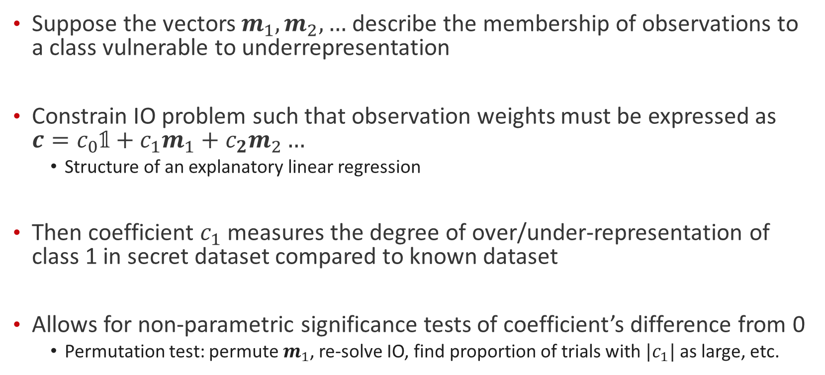
Formally Testing Imbalance Along Certain Classes
Suppose the vectors $m_{1},m_{2},…$describe the membership of observations to a class vulnerable to underrepresentation
Constrain IO problem such that observation weights must be expressed as $c=c_{0}𝟙+c_{1}m_{1}+c_{2}m_{2}…$
Structure of an explanatory linear regression
Then coefficient $c_{1}$ measures the degree of over/under-representation of class 1 in secret dataset compared to known dataset
Allows for non-parametric significance tests of coefficient’s difference from 0
Permutation test: permute $m_{1}$, re-solve IO, find proportion of trials with ${|c}_{1}|$ as large, etc.
Ari Smith: Inverse Optimization and Fairness

Slide 27
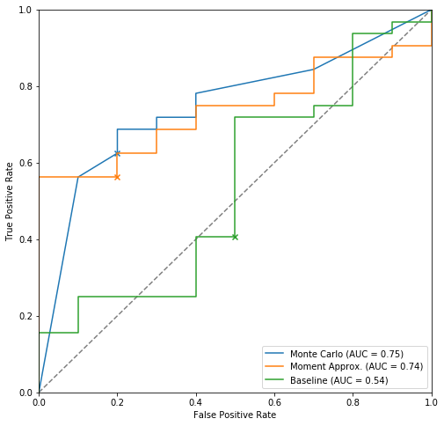
Preliminary Tests of Methods
Train models on Communities and Crime Dataset, intentionally undersampling communities with > 20% black population for some models
Apply inverse optimization analysis with significance tests to detect biased vs. unbiased models
Inverse analysis outperforms baseline method of detecting unfair models by comparing prediction error across groups with explanatory regression
Ari Smith: Inverse Optimization and Fairness

Slide 28
Continued work
Develop improved inverse optimization solution methods for the ML domain
Explore different operationalizations of optimality gap for inverse optimization problem, see which leads to best results
Apply to a case study on a real model with private dataset that is alleged to have bias issues
e.g. Northpointe COMPAS, FICO scoring models, etc.
Ari Smith: Inverse Optimization and Fairness

Slide 29
References

Slide 31
Extra Slides

Slide 32
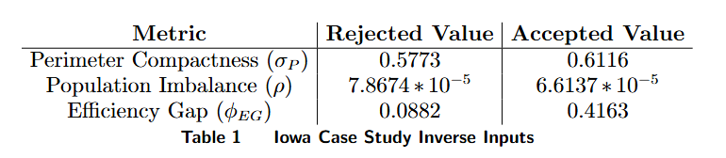
Iowa Case Study Specifics
Metrics of rejected and accepted districtings
Compactness defined using district perimeter, specified by Iowa constitution
Inverse analysis approximated using ensemble of 64 graph coarsenings down to 20 vertices
Ari Smith: Inverse Optimization and Fairness

Slide 33
Experimental Setup: ML Training Set Imbalance Detection
Split a dataset into a secret dataset and a known dataset
Inject bias into secret dataset by undersampling a class of observations
Train 3 types of optimization-based ML models on secret datasets
Linear Regression with Ridge Regularization (Hoerl and Kennard, 1970)
Soft-Margin Support Vector Machines (Cortes and Vapnik, 1995)
Optimal Decision Trees (Bertsimas and Dunn, 2017)
Solve constrained inverse problem on trained models with known dataset and evaluate degree of found bias and statistical significance of coefficient
Ari Smith: Inverse Optimization and Fairness

